Slide 1
NHLBI
Deep Learning Crash Course
National Heart, Lung, and Blood Institute
Fall 2021

Slide 2
Outline
CNN basics
Variation of convolution
Batch Normalization
CNN Examples: LeNet and Alex-Net

Slide 3
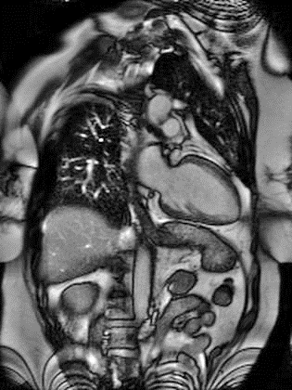
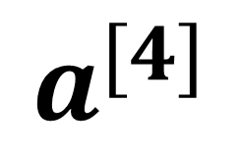
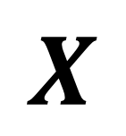
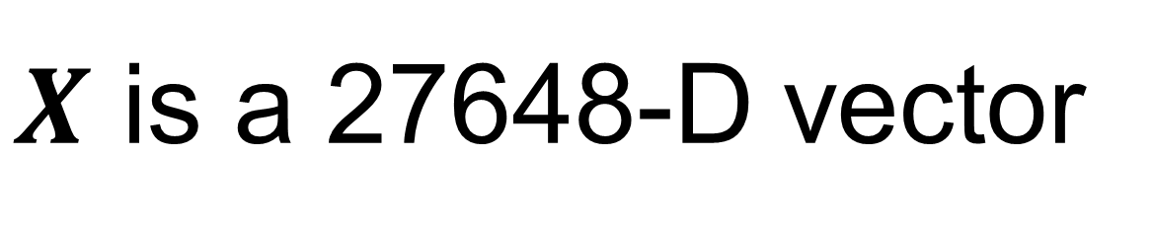
Revisit image classification
W₁^{[1]}
f
W₁^{[2]}
f
W₁^{[3]}
f
… …
… …
… …
flatten
… …
$$X$$
… …
… …
… …
W_{k}^{[1]}
f
W_{k}^{[2]}
f
W_{k}^{[3]}
f
W₁^{[4]}
f
$$a^{[4]}$$
… …
192x144x1
… …
… …
… …
#parameter?
2,764,800+100
~2.8million …
W_{N}^{[1]}
f
W_{N}^{[2]}
f
W_{N}^{[3]}
f
$X$ is a 27648-D vector
For N=100, first weight matrix has the dimension of 100x27648

Slide 4

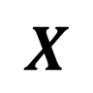
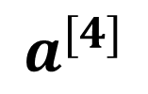
Revisit image classification
red
green
W₁^{[1]}
f
W₁^{[2]}
f
W₁^{[3]}
f
… …
… …
… …
… …
$$X$$
… …
f
… …
f
… …
f
f
W_{k}^{[1]}
W_{k}^{[2]}
W_{k}^{[3]}
W₁^{[4]}
$$a^{[4]}$$
Flatten and concatenate RGB
… …
… …
… …
… …
#parameter?
640x480x3x100+100
~92million …
640x480x3
blue
W_{N}^{[1]}
f
W_{N}^{[2]}
f
W_{N}^{[3]}
f
FC layer is not efficient for image

Slide 5
FC layer is not efficient for image
FC layer is not efficient for image
Too many parameters -> hard to train, easy to get overfitting
Treat all pixels equally; one pixel is connected to all other pixels in the image
Does not utilize the spatial information among neighboring pixels

Slide 6
Spatially invariant feature detection
Edge detection
1 | 0 | -1
2 | 0 | -2
1 | 0 | -1
1 | 2 | 1
0 | 0 | 0
-1 | -2 | -1
Use the same filter “sliding over” the image
Convolution
So no need to have different detectors for the same image features → FC method is not optimal
Sobel filter
Gradient along row
Gradient along column

Slide 7
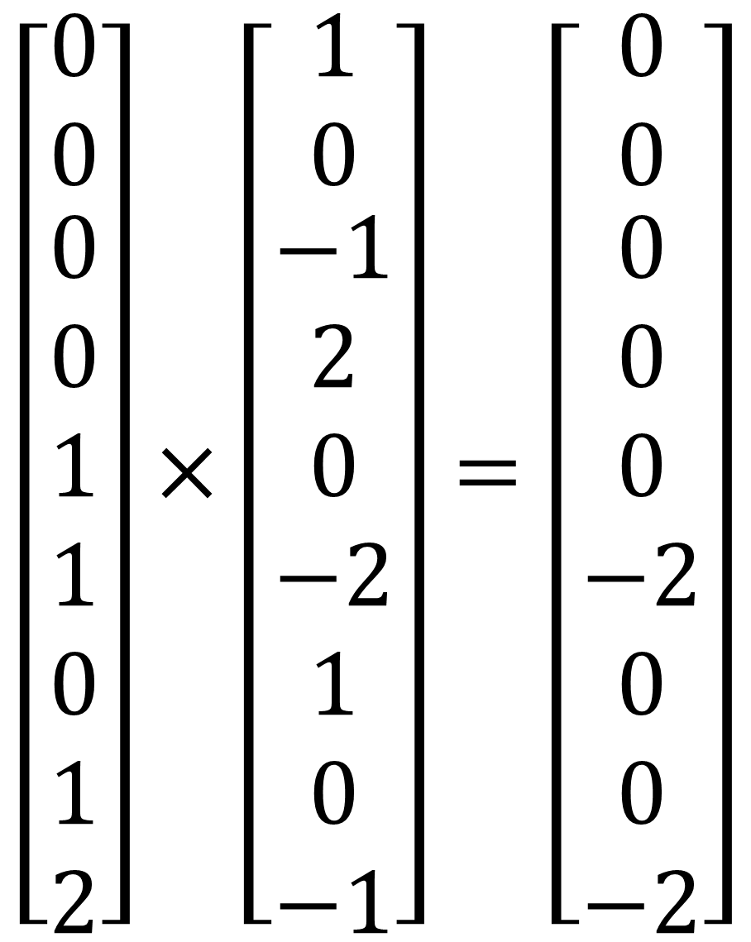
CNN is a spatial-invariant, parameter-sharing FC
Use the convolution operation for spatial invariant → spatial invariant
Use the same filter for the whole image → parameter sharing
1 | 0 | -1
2 | 0 | -2
1 | 0 | -1
$$\left[\begin{matrix}0 \\ 0 \\ \begin{aligned}0 \\ 0 \\ 1 \\ 1 \\ 0 \\ 1 \\ 2\end{aligned}\end{matrix}\right]×\left[\begin{matrix}1 \\ 0 \\ \begin{aligned}−1 \\ 2 \\ 0 \\ −2 \\ 1 \\ 0 \\ −1\end{aligned}\end{matrix}\right]=\left[\begin{matrix}0 \\ 0 \\ \begin{aligned}0 \\ 0 \\ 0 \\ −2 \\ 0 \\ 0 \\ −2\end{aligned}\end{matrix}\right]$$
0 | 0 | 0 | 0 | 0 | 0 | 0 | 0
0 | 1 | 1 | 1 | 1 | 1 | 1 | 0
0 | 1 | 2 | 2 | 2 | 2 | 1 | 0
0 | 1 | 2 | 3 | 3 | 2 | 1 | 0
0 | 1 | 2 | 3 | 3 | 2 | 1 | 0
0 | 1 | 2 | 2 | 2 | 2 | 1 | 0
0 | 1 | 1 | 1 | 1 | 1 | 1 | 0
0 | 0 | 0 | 0 | 0 | 0 | 0 | 0
-4
sum(.)

Slide 8
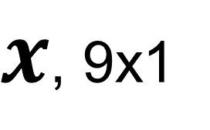
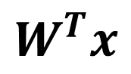
CNN is a spatial-invariant, parameter-sharing FC
Use the convolution operation for spatial invariant → spatial invariant
Use the same filter for the whole image → parameter sharing
1 | 0 | -1
2 | 0 | -2
1 | 0 | -1
0 | 0 | 0 | 0 | 0 | 0 | 0 | 0
0 | 1 | 1 | 1 | 1 | 1 | 1 | 0
0 | 1 | 2 | 2 | 2 | 2 | 1 | 0
0 | 1 | 2 | 3 | 3 | 2 | 1 | 0
0 | 1 | 2 | 3 | 3 | 2 | 1 | 0
0 | 1 | 2 | 2 | 2 | 2 | 1 | 0
0 | 1 | 1 | 1 | 1 | 1 | 1 | 0
0 | 0 | 0 | 0 | 0 | 0 | 0 | 0
$x$, 9x1
-4
$$W^{T}x$$
Take a neighborhood and flatten
Multiple with kernel and sum it up
Can be seen as a local FC

Slide 9
CNN is a spatial-invariant, parameter-sharing FC
Use the convolution operation for spatial invariant → spatial invariant
Use the same filter for the whole image → parameter sharing
1 | 0 | -1
2 | 0 | -2
1 | 0 | -1
0 | 0 | 0 | 0 | 0 | 0 | 0 | 0
0 | 1 | 1 | 1 | 1 | 1 | 1 | 0
0 | 1 | 2 | 2 | 2 | 2 | 1 | 0
0 | 1 | 2 | 3 | 3 | 2 | 1 | 0
0 | 1 | 2 | 3 | 3 | 2 | 1 | 0
0 | 1 | 2 | 2 | 2 | 2 | 1 | 0
0 | 1 | 1 | 1 | 1 | 1 | 1 | 0
0 | 0 | 0 | 0 | 0 | 0 | 0 | 0
$x$, 9x1
-4 | -1
$$W^{T}x$$

Slide 10
CNN is a spatial-invariant, parameter-sharing FC
Use the convolution operation for spatial invariant → spatial invariant
Use the same filter for the whole image → parameter sharing
1 | 0 | -1
2 | 0 | -2
1 | 0 | -1
0 | 0 | 0 | 0 | 0 | 0 | 0 | 0
0 | 1 | 1 | 1 | 1 | 1 | 1 | 0
0 | 1 | 2 | 2 | 2 | 2 | 1 | 0
0 | 1 | 2 | 3 | 3 | 2 | 1 | 0
0 | 1 | 2 | 3 | 3 | 2 | 1 | 0
0 | 1 | 2 | 2 | 2 | 2 | 1 | 0
0 | 1 | 1 | 1 | 1 | 1 | 1 | 0
0 | 0 | 0 | 0 | 0 | 0 | 0 | 0
$x$, 9x1
-4 | -1 | 0
$$W^{T}x$$

Slide 11
CNN is a spatial-invariant, parameter-sharing FC
Use the convolution operation for spatial invariant → spatial invariant
Use the same filter for the whole image → parameter sharing
1 | 0 | -1
2 | 0 | -2
1 | 0 | -1
0 | 0 | 0 | 0 | 0 | 0 | 0 | 0
0 | 1 | 1 | 1 | 1 | 1 | 1 | 0
0 | 1 | 2 | 2 | 2 | 2 | 1 | 0
0 | 1 | 2 | 3 | 3 | 2 | 1 | 0
0 | 1 | 2 | 3 | 3 | 2 | 1 | 0
0 | 1 | 2 | 2 | 2 | 2 | 1 | 0
0 | 1 | 1 | 1 | 1 | 1 | 1 | 0
0 | 0 | 0 | 0 | 0 | 0 | 0 | 0
$x$, 9x1
-4 | -1 | 0 | 0
$$W^{T}x$$

Slide 12
CNN is a spatial-invariant, parameter-sharing FC
Use the convolution operation for spatial invariant → spatial invariant
Use the same filter for the whole image → parameter sharing
1 | 0 | -1
2 | 0 | -2
1 | 0 | -1
0 | 0 | 0 | 0 | 0 | 0 | 0 | 0
0 | 1 | 1 | 1 | 1 | 1 | 1 | 0
0 | 1 | 2 | 2 | 2 | 2 | 1 | 0
0 | 1 | 2 | 3 | 3 | 2 | 1 | 0
0 | 1 | 2 | 3 | 3 | 2 | 1 | 0
0 | 1 | 2 | 2 | 2 | 2 | 1 | 0
0 | 1 | 1 | 1 | 1 | 1 | 1 | 0
0 | 0 | 0 | 0 | 0 | 0 | 0 | 0
$x$, 9x1
-4 | -1 | 0 | 0 | 1
$$W^{T}x$$

Slide 13
CNN is a spatial-invariant, parameter-sharing FC
Use the convolution operation for spatial invariant → spatial invariant
Use the same filter for the whole image → parameter sharing
1 | 0 | -1
2 | 0 | -2
1 | 0 | -1
0 | 0 | 0 | 0 | 0 | 0 | 0 | 0
0 | 1 | 1 | 1 | 1 | 1 | 1 | 0
0 | 1 | 2 | 2 | 2 | 2 | 1 | 0
0 | 1 | 2 | 3 | 3 | 2 | 1 | 0
0 | 1 | 2 | 3 | 3 | 2 | 1 | 0
0 | 1 | 2 | 2 | 2 | 2 | 1 | 0
0 | 1 | 1 | 1 | 1 | 1 | 1 | 0
0 | 0 | 0 | 0 | 0 | 0 | 0 | 0
$x$, 9x1
-4 | -1 | 0 | 0 | 1 | 4
$$W^{T}x$$

Slide 14
CNN is a spatial-invariant, parameter-sharing FC
Use the convolution operation for spatial invariant → spatial invariant
Use the same filter for the whole image → parameter sharing
1 | 0 | -1
2 | 0 | -2
1 | 0 | -1
0 | 0 | 0 | 0 | 0 | 0 | 0 | 0
0 | 1 | 1 | 1 | 1 | 1 | 1 | 0
0 | 1 | 2 | 2 | 2 | 2 | 1 | 0
0 | 1 | 2 | 3 | 3 | 2 | 1 | 0
0 | 1 | 2 | 3 | 3 | 2 | 1 | 0
0 | 1 | 2 | 2 | 2 | 2 | 1 | 0
0 | 1 | 1 | 1 | 1 | 1 | 1 | 0
0 | 0 | 0 | 0 | 0 | 0 | 0 | 0
$x$, 9x1
-4 | -1 | 0 | 0 | 1 | 4
-7
$$W^{T}x$$

Slide 15
CNN is a spatial-invariant, parameter-sharing FC
Use the convolution operation for spatial invariant → spatial invariant
Use the same filter for the whole image → parameter sharing
1 | 0 | -1
2 | 0 | -2
1 | 0 | -1
0 | 0 | 0 | 0 | 0 | 0 | 0 | 0
0 | 1 | 1 | 1 | 1 | 1 | 1 | 0
0 | 1 | 2 | 2 | 2 | 2 | 1 | 0
0 | 1 | 2 | 3 | 3 | 2 | 1 | 0
0 | 1 | 2 | 3 | 3 | 2 | 1 | 0
0 | 1 | 2 | 2 | 2 | 2 | 1 | 0
0 | 1 | 1 | 1 | 1 | 1 | 1 | 0
0 | 0 | 0 | 0 | 0 | 0 | 0 | 0
$x$, 9x1
-4 | -1 | 0 | 0 | 1 | 4
-7 | -4
$$W^{T}x$$

Slide 16
CNN is a spatial-invariant, parameter-sharing FC
Use the convolution operation for spatial invariant → spatial invariant
Use the same filter for the whole image → parameter sharing
1 | 0 | -1
2 | 0 | -2
1 | 0 | -1
0 | 0 | 0 | 0 | 0 | 0 | 0 | 0
0 | 1 | 1 | 1 | 1 | 1 | 1 | 0
0 | 1 | 2 | 2 | 2 | 2 | 1 | 0
0 | 1 | 2 | 3 | 3 | 2 | 1 | 0
0 | 1 | 2 | 3 | 3 | 2 | 1 | 0
0 | 1 | 2 | 2 | 2 | 2 | 1 | 0
0 | 1 | 1 | 1 | 1 | 1 | 1 | 0
0 | 0 | 0 | 0 | 0 | 0 | 0 | 0
$x$, 9x1
-4 | -1 | 0 | 0 | 1 | 4
-7 | -4 | -1 | 1 | 4 | 7
-8 | -7 | -3 | 3 | 7 | 8
-8 | -7 | -3 | 3 | 7 | 8
-7 | -4 | -1 | 1 | 4 | 7
-4 | -1 | 0 | 0 | 1 | 4
$$W^{T}x$$

Slide 17
CNN is a spatial-invariant, parameter-sharing FC
Use the convolution operation for spatial invariant → spatial invariant
Use the same filter for the whole image → parameter sharing
1 | 0 | -1
2 | 0 | -2
1 | 0 | -1
0 | 0 | 0 | 0 | 0 | 0 | 0 | 0
0 | 1 | 1 | 1 | 1 | 1 | 1 | 0
0 | 1 | 2 | 2 | 2 | 2 | 1 | 0
0 | 1 | 2 | 3 | 3 | 2 | 1 | 0
0 | 1 | 2 | 3 | 3 | 2 | 1 | 0
0 | 1 | 2 | 2 | 2 | 2 | 1 | 0
0 | 1 | 1 | 1 | 1 | 1 | 1 | 0
0 | 0 | 0 | 0 | 0 | 0 | 0 | 0
Higher value in outputs indicate “vertical edges”
With direction information (gradient direction)
$x$, 9x1
-4 | -1 | 0 | 0 | 1 | 4
-7 | -4 | -1 | 1 | 4 | 7
-8 | -7 | -3 | 3 | 7 | 8
-8 | -7 | -3 | 3 | 7 | 8
-7 | -4 | -1 | 1 | 4 | 7
-4 | -1 | 0 | 0 | 1 | 4
$$W^{T}x$$

Slide 18
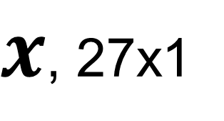

CNN layer with multiple channels
Kernel has multiple channels too
Sum over all channels
Image: $H×W×C$
Kernel: $k_{x}×k_{y}×C$
1 | 0 | -1
2 | 0 | -2
1 | 0 | -1
0 | 0 | 0 | 0 | 0 | 0 | 0 | 0
0 | 1 | 1 | 1 | 1 | 1 | 1 | 0
0 | 1 | 2 | 2 | 2 | 2 | 1 | 0
0 | 1 | 2 | 3 | 3 | 2 | 1 | 0
0 | 1 | 2 | 3 | 3 | 2 | 1 | 0
0 | 1 | 2 | 2 | 2 | 2 | 1 | 0
0 | 1 | 1 | 1 | 1 | 1 | 1 | 0
0 | 0 | 0 | 0 | 0 | 0 | 0 | 0
$x$, 27x1
0
$$W^{T}x$$

Slide 19
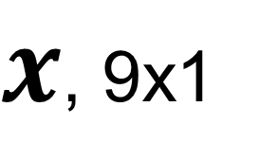
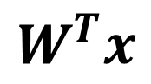
Padding
Pixels on the boundary was not explored
Reduced output size
1 | 0 | -1
2 | 0 | -2
1 | 0 | -1
Padding = 1
 |  |  | 0 | 0 | 0 | 0 | 0 | 0 | 0
 | 0 | 0 | 0 | 0 | 0 | 0 | 0 | 0 | 0
 | 0 | 1 | 1 | 1 | 1 | 1 | 1 | 0 | 0
0 | 0 | 1 | 2 | 2 | 2 | 2 | 1 | 0 | 0
0 | 0 | 1 | 2 | 3 | 3 | 2 | 1 | 0 | 0
0 | 0 | 1 | 2 | 3 | 3 | 2 | 1 | 0 | 0
0 | 0 | 1 | 2 | 2 | 2 | 2 | 1 | 0 | 0
0 | 0 | 1 | 1 | 1 | 1 | 1 | 1 | 0 | 0
0 | 0 | 0 | 0 | 0 | 0 | 0 | 0 | 0 | 0
0 | 0 | 0 | 0 | 0 | 0 | 0 | 0 | 0 | 0
0 | 0 | 0
0
0
-1 | -1 | 0 | 0 | 0 | 0 | 1 | 1
-3 | -4 | -1 | 0 | 0 | 1 | 4 | -3
-4 | -7 | -4 | -1 | 1 | 4 | 7 | -4
-4 | -8 | -7 | -3 | 3 | 7 | 8 | -4
-4 | -8 | -7 | -3 | 3 | 7 | 8 | -4
-4 | -7 | -4 | -1 | 1 | 4 | 7 | -4
-3 | -4 | -1 | 0 | 0 | 1 | 4 | -3
-1 | -1 | 0 | 0 | 0 | 0 | 1 | 1
$x$, 9x1
$$W^{T}x$$
Often pad with 0
Other choices : replica, mirror, periodic

Slide 20
Stride
When sliding the kernel over the image, the moving stepsize is the stride
Default is 1, but stride can be larger than 1
Often used to reduce output size
Stride=2 along row
0 | 0 | 0 | 0 | 0 | 0 | 0 | 0
0 | 1 | 1 | 1 | 1 | 1 | 1 | 0
0 | 1 | 2 | 2 | 2 | 2 | 1 | 0
0 | 1 | 2 | 3 | 3 | 2 | 1 | 0
0 | 1 | 2 | 3 | 3 | 2 | 1 | 0
0 | 1 | 2 | 2 | 2 | 2 | 1 | 0
0 | 1 | 1 | 1 | 1 | 1 | 1 | 0
0 | 0 | 0 | 0 | 0 | 0 | 0 | 0
$x$, 9x1
-4 |  | 0
$$W^{T}x$$

Slide 21
Stride
When sliding the kernel over the image, the moving stepsize is the stride
Default is 1, but stride can be larger than 1
Often used to reduce output size
Stride=2 along column
0 | 0 | 0 | 0 | 0 | 0 | 0 | 0
0 | 1 | 1 | 1 | 1 | 1 | 1 | 0
0 | 1 | 2 | 2 | 2 | 2 | 1 | 0
0 | 1 | 2 | 3 | 3 | 2 | 1 | 0
0 | 1 | 2 | 3 | 3 | 2 | 1 | 0
0 | 1 | 2 | 2 | 2 | 2 | 1 | 0
0 | 1 | 1 | 1 | 1 | 1 | 1 | 0
0 | 0 | 0 | 0 | 0 | 0 | 0 | 0
$x$, 9x1
-4
-8
$$W^{T}x$$

Slide 22
Stride
When sliding the kernel over the image, the moving stepsize is the stride
Default is 1, but stride can be larger than 1
Often used to reduce output size
Input 8x8
Kernel 3x3
Output 3x3
With padding=0, stride=2 for H and W
0 | 0 | 0 | 0 | 0 | 0 | 0 | 0
0 | 1 | 1 | 1 | 1 | 1 | 1 | 0
0 | 1 | 2 | 2 | 2 | 2 | 1 | 0
0 | 1 | 2 | 3 | 3 | 2 | 1 | 0
0 | 1 | 2 | 3 | 3 | 2 | 1 | 0
0 | 1 | 2 | 2 | 2 | 2 | 1 | 0
0 | 1 | 1 | 1 | 1 | 1 | 1 | 0
0 | 0 | 0 | 0 | 0 | 0 | 0 | 0
$x$, 9x1
-4 |  | 0 |  | 1
-8 |  | -3 |  | 7
-7 |  | -1 |  | 4
$$W^{T}x$$

Slide 23
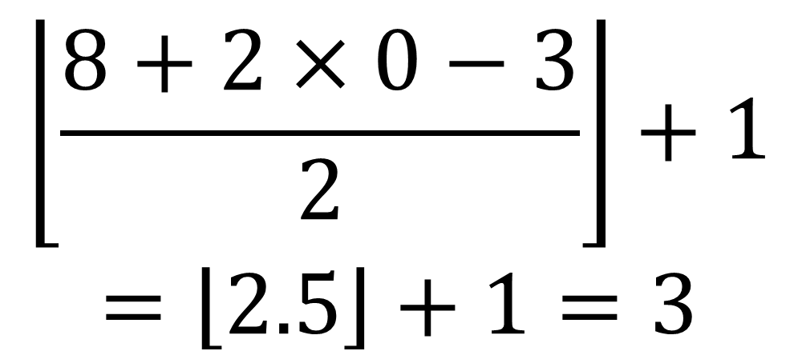
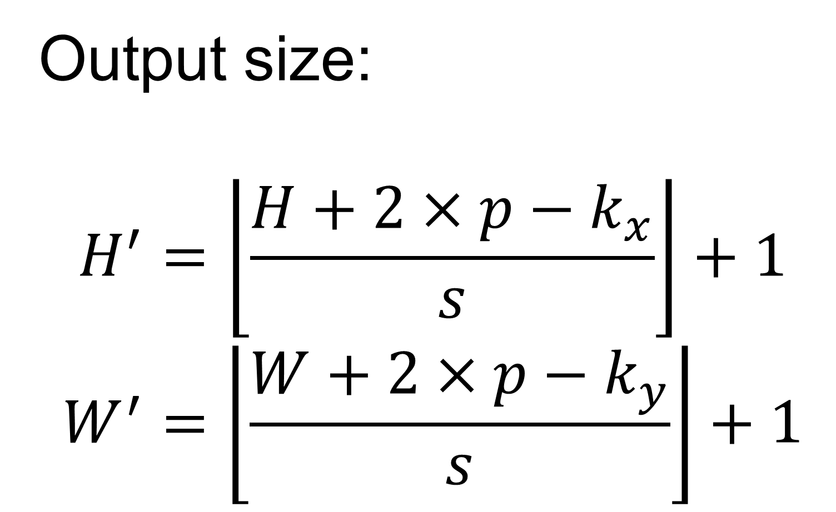
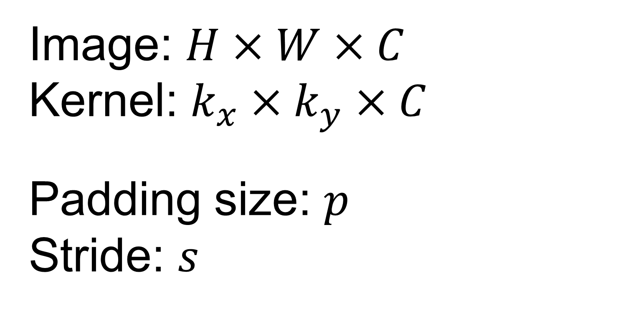
Determine the output size
Output size:
$$H^{′}=\left\lfloor \left.\frac{H+2×p−k_{x}}{s}\right\rfloor \right.+1$$
$$W^{′}=\left\lfloor \left.\frac{W+2×p−k_{y}}{s}\right\rfloor \right.+1$$
Image: $H×W×C$
Kernel: $k_{x}×k_{y}×C$
Padding size: $p$
Stride: $s$
$$\left\lfloor \left.\frac{8+2×0−3}{2}\right\rfloor \right.+1$$
$$=\left\lfloor \left.2.5\right\rfloor \right.+1=3$$
0 | 0 | 0 | 0 | 0 | 0 | 0 | 0
0 | 1 | 1 | 1 | 1 | 1 | 1 | 0
0 | 1 | 2 | 2 | 2 | 2 | 1 | 0
0 | 1 | 2 | 3 | 3 | 2 | 1 | 0
0 | 1 | 2 | 3 | 3 | 2 | 1 | 0
0 | 1 | 2 | 2 | 2 | 2 | 1 | 0
0 | 1 | 1 | 1 | 1 | 1 | 1 | 0
0 | 0 | 0 | 0 | 0 | 0 | 0 | 0
$x$, 9x1
-4 |  | 0 |  | 1
-8 |  | -3 |  | 7
-7 |  | -1 |  | 4
Stride can be used to reduce image size
$$W^{T}x$$

Slide 24
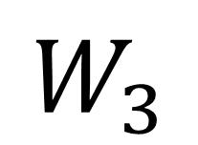
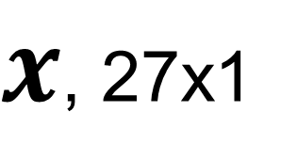
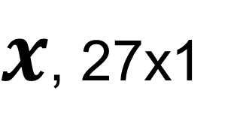
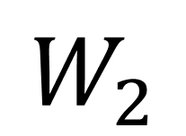
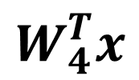
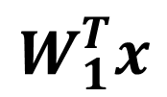
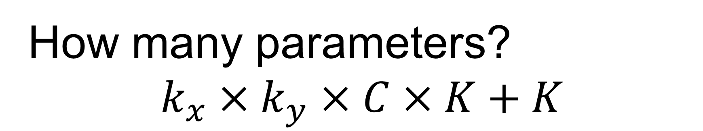
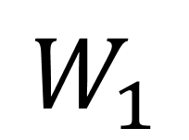
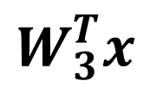
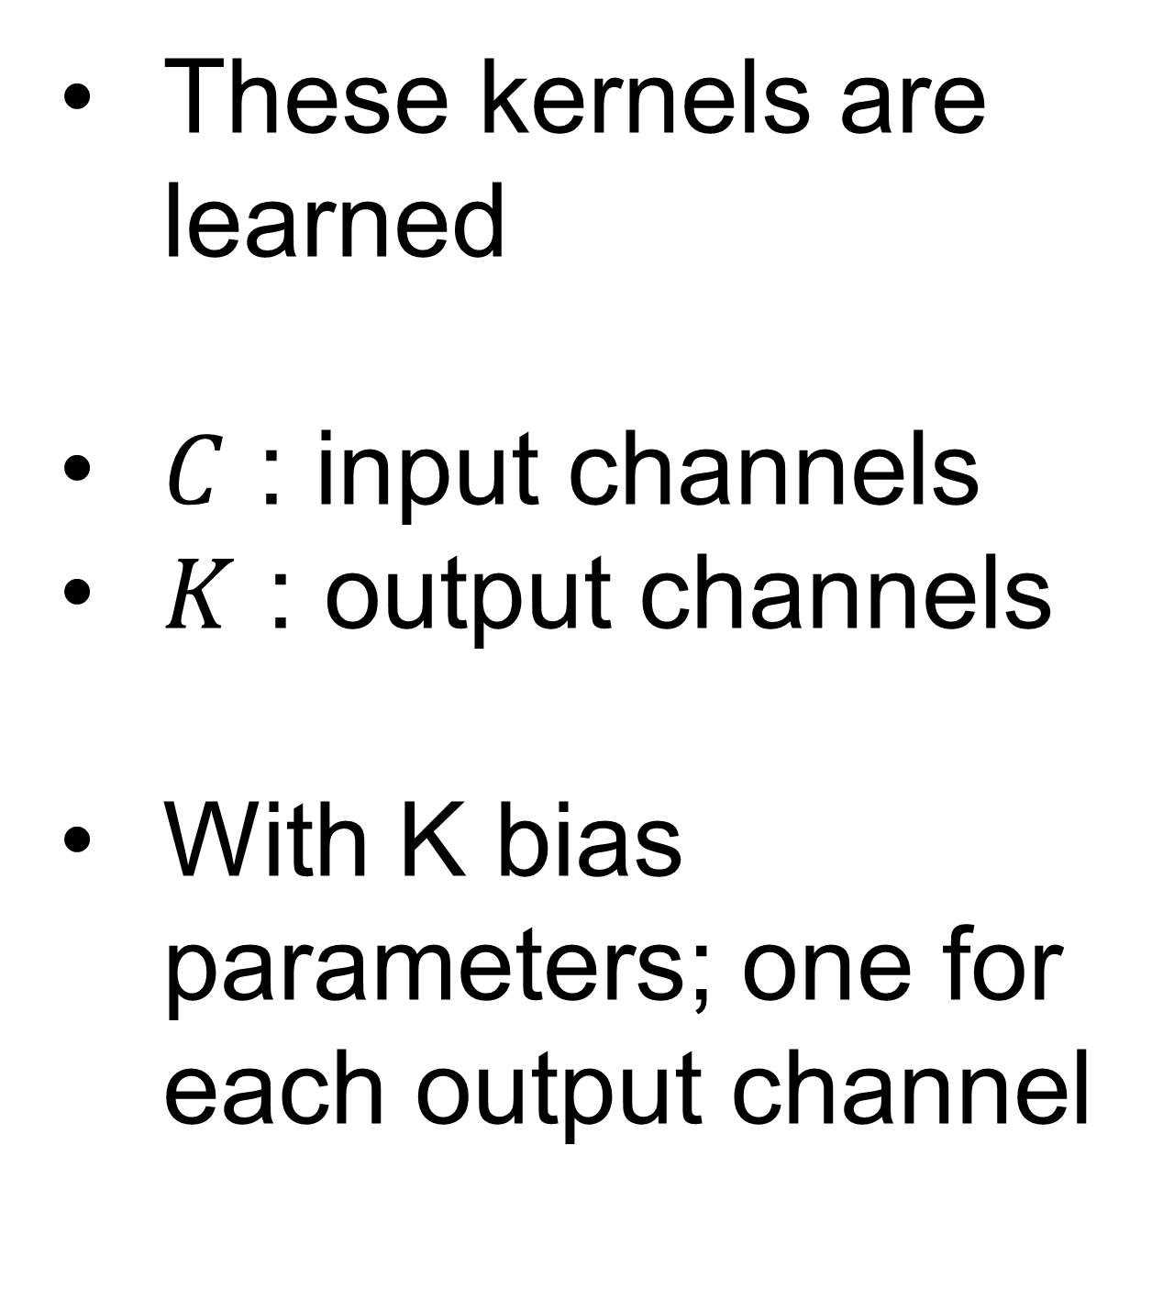
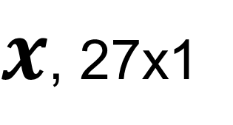
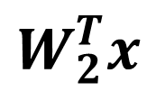
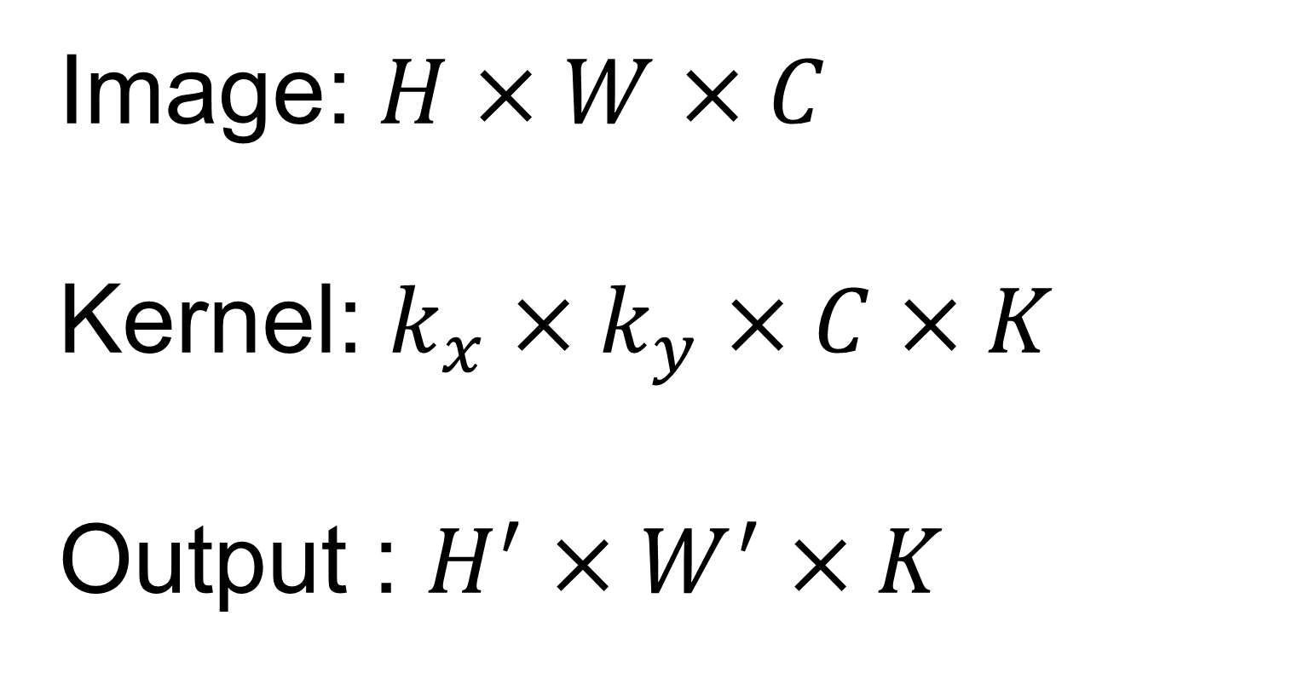
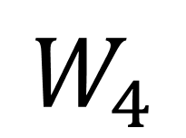
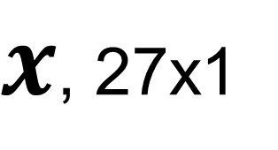
Multiple kernels
For one location in the image, multiple kernels can be used to capture different features
Image: $H×W×C$
Kernel: $k_{x}×k_{y}×C×K$
Output : $H^{′}×W^{′}×K$
1 | 0 | -1
2 | 0 | -2
1 | 0 | -1
1 | 2 | 1
0 | 0 | 0
-1 | -2 | -1
1 | 0 | 0
0 | 1 | 0
0 | 0 | 1
1 | 1 | 0
1 | 0 | 0
0 | 0 | 0
$$W_{1}$$
$$W_{2}$$
$$W_{3}$$
$$W_{4}$$
These kernels are learned
$C$ : input channels
$K$ : output channels
With K bias parameters; one for each output channel
0 | 0 | 0 | 0 | 0 | 0 | 0 | 0
0 | 1 | 1 | 1 | 1 | 1 | 1 | 0
0 | 1 | 2 | 2 | 2 | 2 | 1 | 0
0 | 1 | 2 | 3 | 3 | 2 | 1 | 0
0 | 1 | 2 | 3 | 3 | 2 | 1 | 0
0 | 1 | 2 | 2 | 2 | 2 | 1 | 0
0 | 1 | 1 | 1 | 1 | 1 | 1 | 0
0 | 0 | 0 | 0 | 0 | 0 | 0 | 0
$x$, 27x1
$$W_{1}^{T}x$$
$x$, 27x1
$$W_{2}^{T}x$$
Feature maps
$x$, 27x1
$x$, 27x1
$$W_{3}^{T}x$$
$$W_{4}^{T}x$$
How many parameters?
$$k_{x}×k_{y}×C×K+K$$

Slide 25
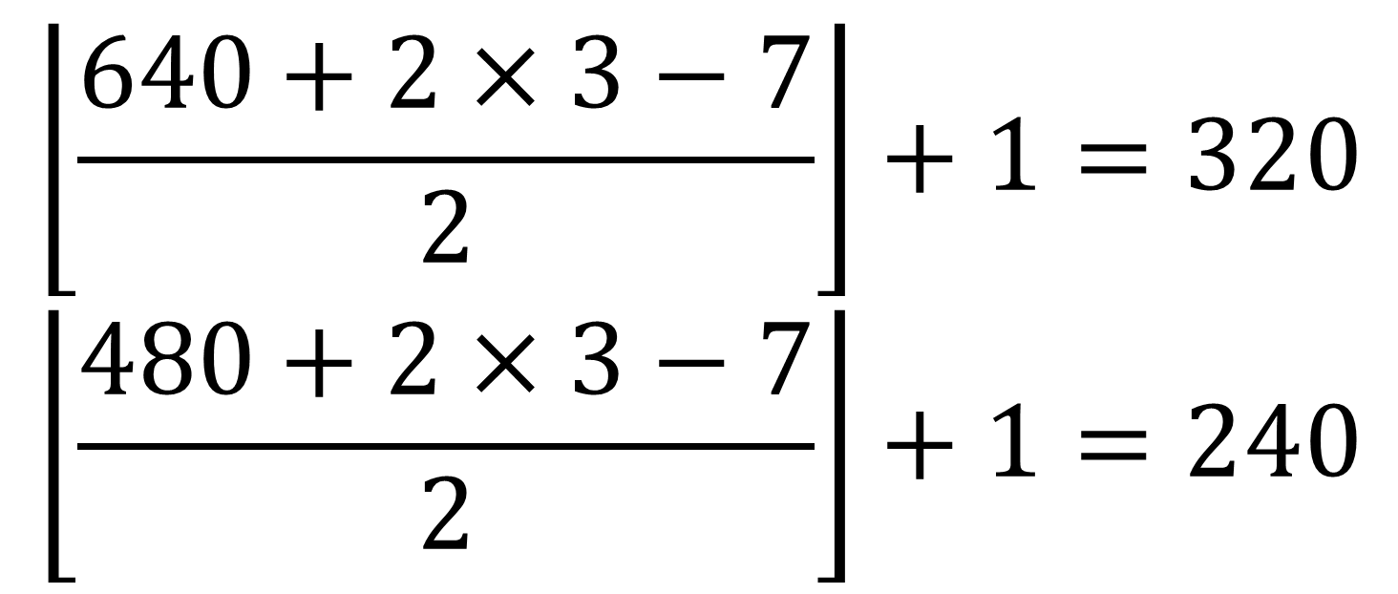
Multiple CONV layers can be stacked
Nonlinearity (e.g. ReLU) is applied to every element on feature maps
$$\left\lfloor \left.\frac{640+2×3−7}{2}\right\rfloor \right.+1=320$$
$$\left\lfloor \left.\frac{480+2×3−7}{2}\right\rfloor \right.+1=240$$
3x640x480
Kernel: 7x7x3x16,
16 biases
CONV
7x7, p=3, s=2, K=16
16x320x240
Total number of parameters:
7x7x3x16+16+5x5x16x32+32+3x3x32x64+64+256x307200+256+1x256+1 = 78,677409, ~78million
One FC layer claims 99.96%
ReLU
16x320x240
logit
Kernel: 5x5x16x32,
32 biases
W: 1x256,
1 biases
CONV
5x5, p=2, s=2 , K=32
FC, D=1
32x160x120
256x1
ReLU
32x160x120
Kernel: 3x3x32x64,
64 biases
ReLU
W: 256x307200,
256 biases
FC, D=256
CONV
3x3, p=1, s=2 , K=64
64x80x60
307200x1
ReLU
Flatten
64x80x60

Slide 26
Receptive field
Every CONV filter looks at a small neighborhood
May need to look at more global structure in the image?
Receptive field : the region in the image to impact a feature after some CONV layers
8x8x3
Kernel:
3x3x1, p=0, s=1
Kernel:
3x3x1, p=0, s=1
0 | 0 | 0 | 0 | 0 | 0 | 0 | 0
0 | 1 | 1 | 1 | 1 | 1 | 1 | 0
0 | 1 | 2 | 2 | 2 | 2 | 1 | 0
0 | 1 | 2 | 3 | 3 | 2 | 1 | 0
0 | 1 | 2 | 3 | 3 | 2 | 1 | 0
0 | 1 | 2 | 2 | 2 | 2 | 1 | 0
0 | 1 | 1 | 1 | 1 | 1 | 1 | 0
0 | 0 | 0 | 0 | 0 | 0 | 0 | 0
With deeper network, the receptive field increases

Slide 27
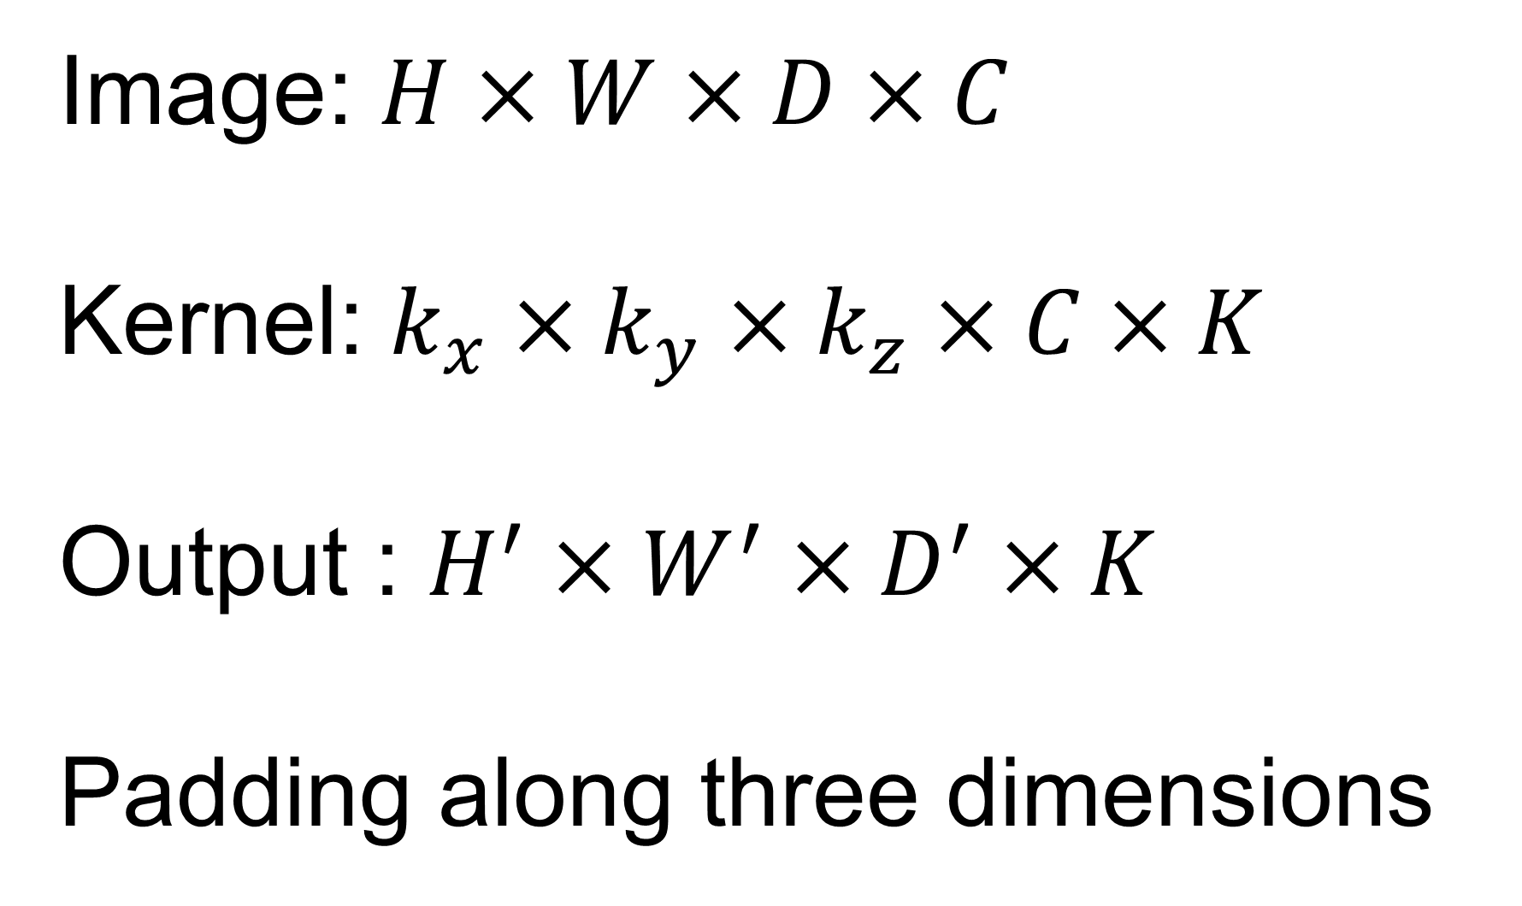
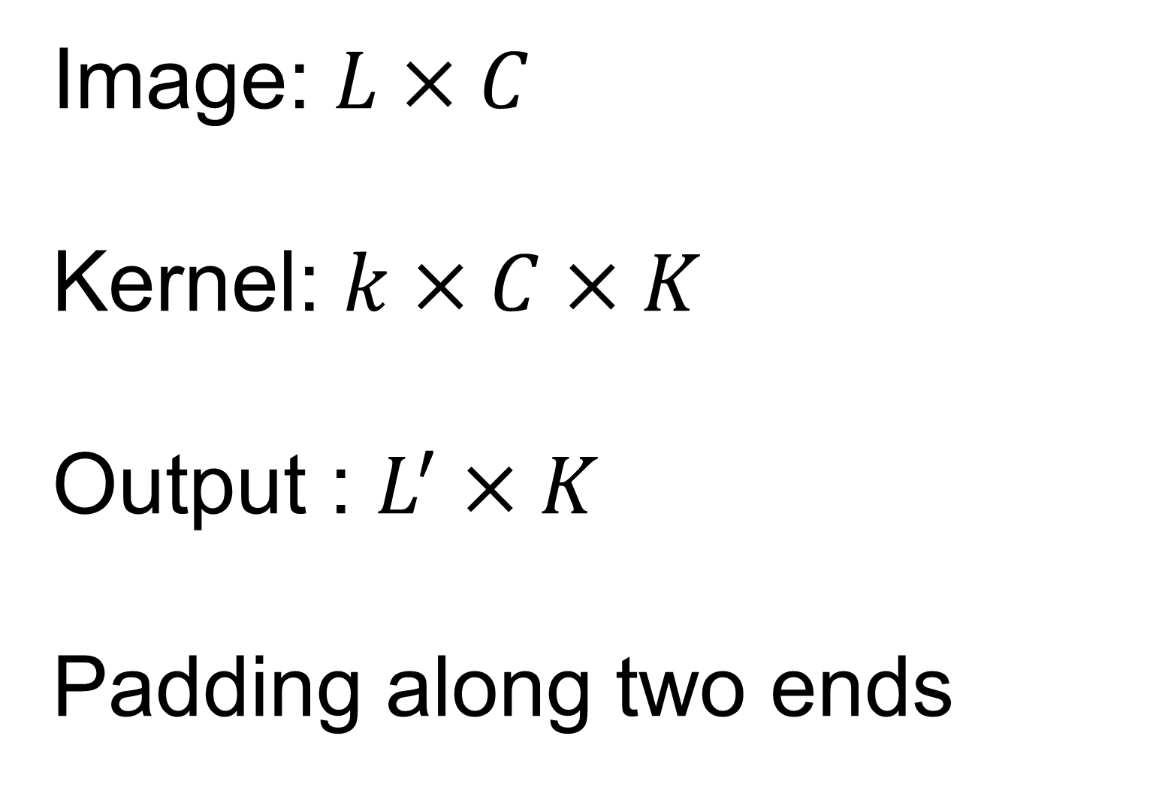
1D and 3D convolution
Computation is the same as the 2D CONV
0 | 0 | 0 | 0 | 0 | 0 | 0 | 0
0 | 1 | 1 | 1 | 1 | 1 | 1 | 0
0 | 1 | 2 | 2 | 2 | 2 | 1 | 0
0 | 1 | 2 | 3 | 3 | 2 | 1 | 0
0 | 1 | 2 | 3 | 3 | 2 | 1 | 0
0 | 1 | 2 | 2 | 2 | 2 | 1 | 0
0 | 1 | 1 | 1 | 1 | 1 | 1 | 0
0 | 0 | 0 | 0 | 0 | 0 | 0 | 0
1 | 0 | -1
0 | 1 | 2 | 3 | 3 | 2 | 1 | 0
Image: $H×W×D×C$
Kernel: $k_{x}×k_{y}×k_{z}×C×K$
Output : $H^{′}×W^{′}×D^{′}×K$
Padding along three dimensions
Image: $L×C$
Kernel: $k×C×K$
Output : $L^{′}×K$
Padding along two ends

Slide 28

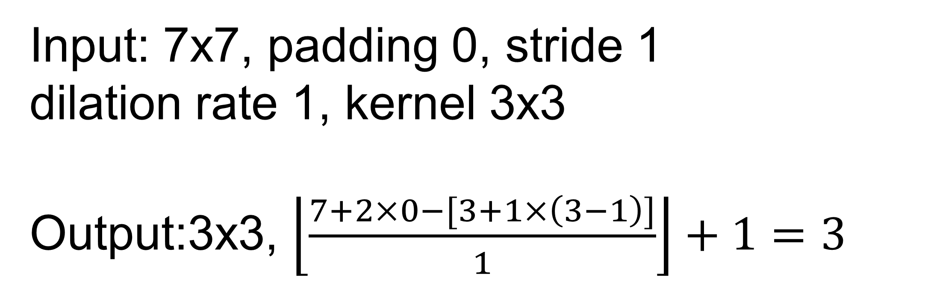
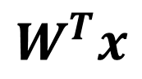
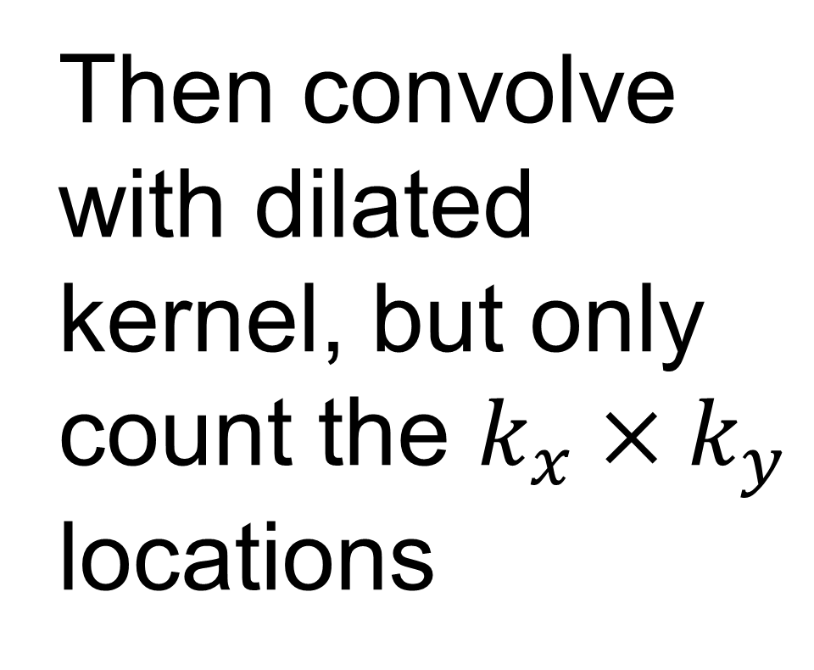
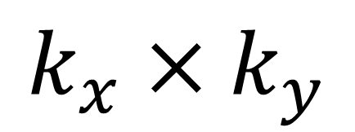
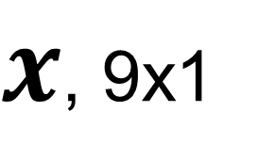
Dilated convolution
Increase receptive field by “skipping pixels” in input images
$$k_{x}×k_{y}$$
Dilate kernel with the dilation rate 1
$$[k_{x}+d\left(k_{x}−1\right)]×[k_{y}+d\left(k_{y}−1\right)]$$
1 |  | 0 |  | -1
2 |  | 0 |  | -2
1 |  | 0 |  | -1
1 | 0 | -1
2 | 0 | -2
1 | 0 | -1
0 | 0 | 0 | 0 | 0 | 0 | 0 | 0
0 | 1 | 1 | 1 | 1 | 1 | 1 | 0
0 | 1 | 2 | 2 | 2 | 2 | 1 | 0
0 | 1 | 2 | 3 | 3 | 2 | 1 | 0
0 | 1 | 2 | 3 | 3 | 2 | 1 | 0
0 | 1 | 2 | 2 | 2 | 2 | 1 | 0
0 | 1 | 1 | 1 | 1 | 1 | 1 | 0
0 | 0 | 0 | 0 | 0 | 0 | 0 | 0
[1 1 1 1 3 2 1 2 2]
X
[1 0 -1 2 0 -2 1 0 -1]^{T} = -3
$x$, 9x1
$$W^{T}x$$
Then convolve with dilated kernel, but only count the $k_{x}×k_{y}$ locations
Input: 7x7, padding 0, stride 1
dilation rate 1, kernel 3x3
Output:3x3, $\left\lfloor \frac{7+2×0−[3+1×\left(3−1\right)]}{1}\right\rfloor +1=3$
Animation is from https://github.com/vdumoulin/conv_arithmetic

Slide 29

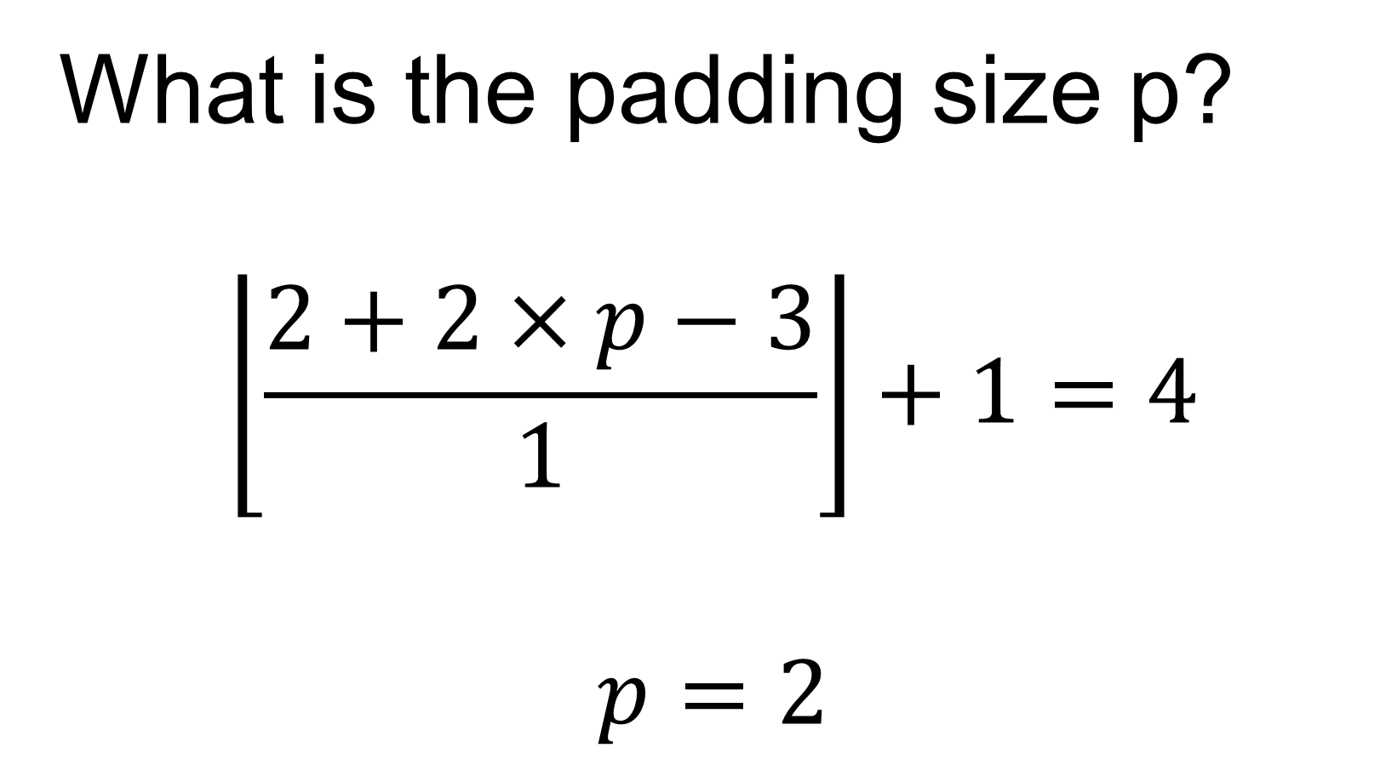
Transpose convolution
Increase image size after convolution – often used to upsample feature maps
Input: 2x2, padding 0, stride 1
Kernel: 3x3
Required Output:4x4
Determine padding size
Sliding over the output
For every location in output, take the corresponding pixels in input maps and apply the kernel
What is the padding size p?
$$\left\lfloor \frac{2+2×p−3}{1}\right\rfloor +1=4$$
$$p=2$$
Animation is from https://github.com/vdumoulin/conv_arithmetic

Slide 30
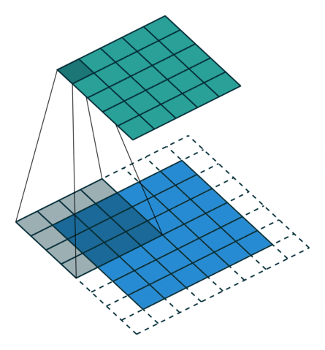
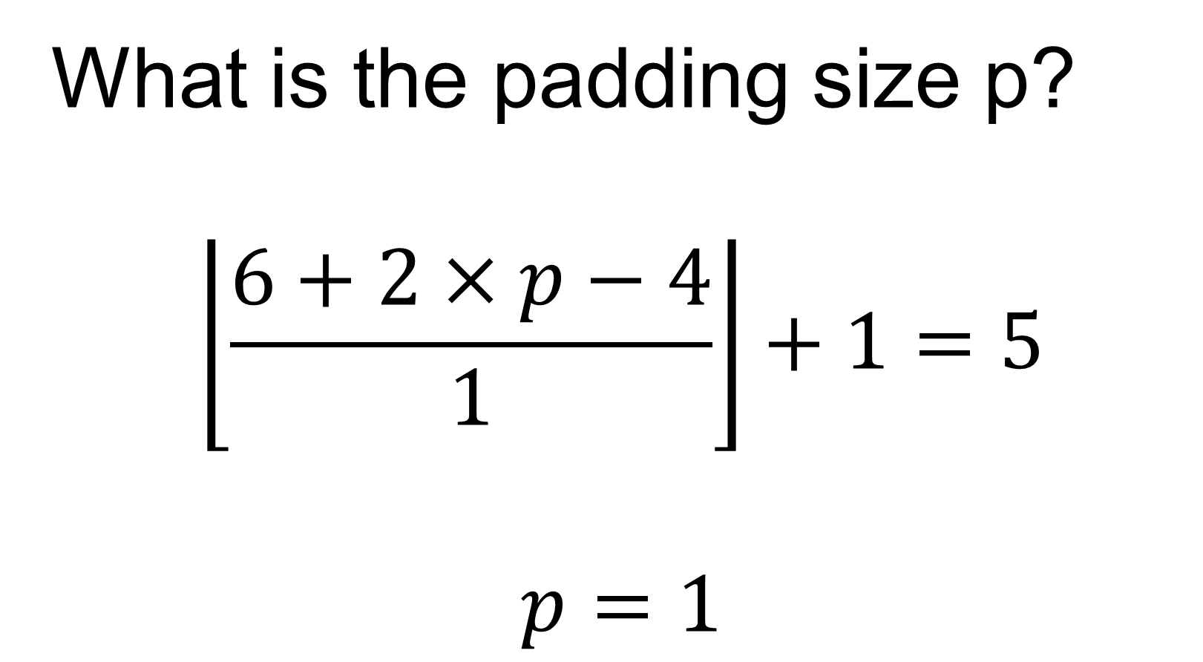
Transpose convolution
Increase image size after convolution – often used to upsample feature maps
Input: 6x6, padding 0, stride 1
Kernel: 4x4
Required Output:5x5
Determine padding size
Sliding over the output
For every location in output, take the corresponding pixels in input maps and apply the kernel
What is the padding size p?
$$\left\lfloor \frac{6+2×p−4}{1}\right\rfloor +1=5$$
$$p=1$$
Animation is from https://github.com/vdumoulin/conv_arithmetic

Slide 31
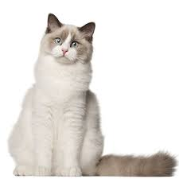
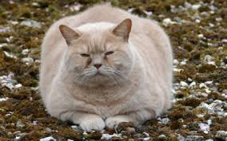
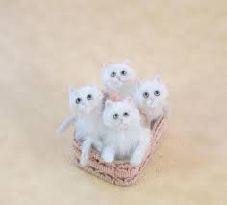
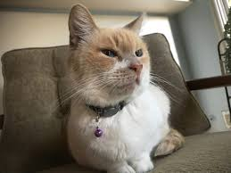
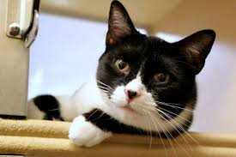
Convolution is shift-invariant, not for rotation and scale
CONV cannot deal with arbitrary spatial transformation
More general, the training and test sets can have different distribution
conv
conv
Training set, cats are roughly the same size
A test sample, small cat

Slide 32


Data augmentation
Introduce variation in the training data, so model can learn invariance
Randomly apply different transformations
And many more …
Check http://ai.stanford.edu/blog/data-augmentation/

Slide 33
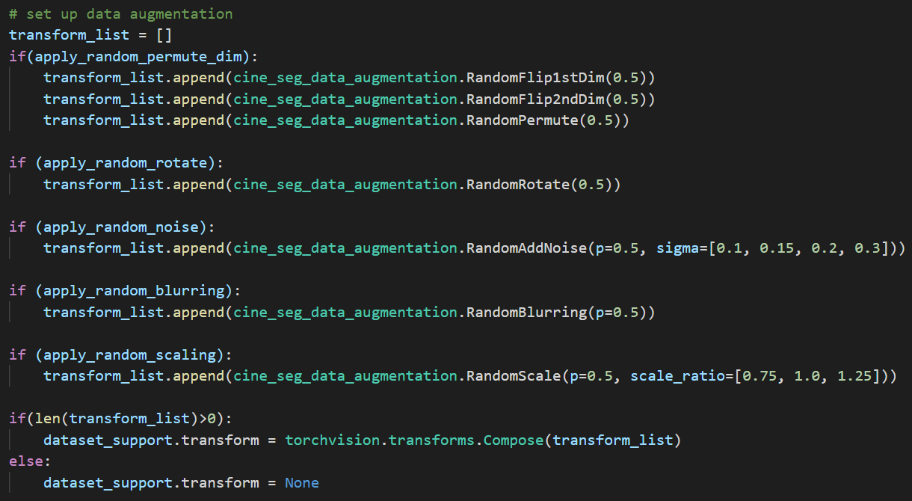

Data augmentation
Do not generate these random samples and save them
Instead, implement them as a part of data loading
T₁
_{P=0.5}
T₂
_{P=0.8}
T₃
_{P=0.2}
T_{N}
_{P=0.5}
… …
Input to training
P: probability to apply the transformation
More examples can be found at https://pytorch.org/vision/stable/auto_examples/plot_transforms.html#sphx-glr-auto-examples-plot-transforms-py

Slide 34
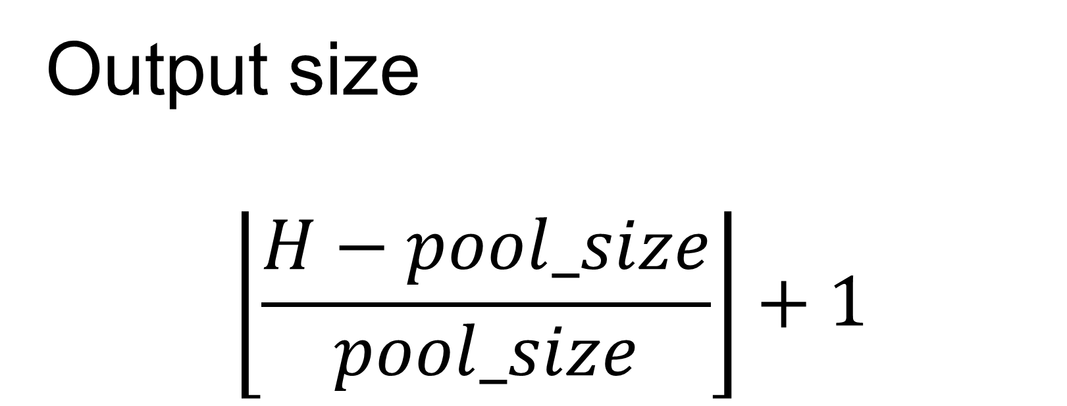
Pooling : another way to reduce computation
Often used to reduce the image size
Parameter free
Input: 8x8
Pool size: 2x2
Take every 2x2 neighborhood, compute its max (max pool) or average (averaging pool)
Typically, no padding, stride equals to the pool_size
0 | 0 | 0 | 0 | 0 | 0 | 0 | 0
0 | 1 | 1 | 1 | 1 | 1 | 1 | 0
0 | 1 | 2 | 2 | 2 | 2 | 1 | 0
0 | 1 | 2 | 3 | 3 | 2 | 1 | 0
0 | 1 | 2 | 3 | 3 | 2 | 1 | 0
0 | 1 | 2 | 2 | 2 | 2 | 1 | 0
0 | 1 | 1 | 1 | 1 | 1 | 1 | 0
0 | 0 | 0 | 0 | 0 | 0 | 0 | 0
1
Max pool
Output size
$$\left\lfloor \frac{H−pool_size}{pool_size}\right\rfloor +1$$

Slide 35
Pooling : another way to reduce computation
Often used to reduce the image size
Parameter free
Input: 8x8
Pool size: 2x2
Take every 2x2 neighborhood, compute its max (max pool) or average (averaging pool)
Typically, no padding, stride equals to the pool_size
0 | 0 | 0 | 0 | 0 | 0 | 0 | 0
0 | 1 | 1 | 1 | 1 | 1 | 1 | 0
0 | 1 | 2 | 2 | 2 | 2 | 1 | 0
0 | 1 | 2 | 3 | 3 | 2 | 1 | 0
0 | 1 | 2 | 3 | 3 | 2 | 1 | 0
0 | 1 | 2 | 2 | 2 | 2 | 1 | 0
0 | 1 | 1 | 1 | 1 | 1 | 1 | 0
0 | 0 | 0 | 0 | 0 | 0 | 0 | 0
1 | 1 | 1 | 1
1 | 3
Max pool
Output size
$$\left\lfloor \frac{H−pool_size}{pool_size}\right\rfloor +1$$

Slide 36
Pooling : another way to reduce computation
Often used to reduce the image size
Parameter free
Input: 8x8
Pool size: 2x2
Take every 2x2 neighborhood, compute its max (max pool) or average (averaging pool)
Typically, no padding, stride equals to the pool_size
0 | 0 | 0 | 0 | 0 | 0 | 0 | 0
0 | 1 | 1 | 1 | 1 | 1 | 1 | 0
0 | 1 | 2 | 2 | 2 | 2 | 1 | 0
0 | 1 | 2 | 3 | 3 | 2 | 1 | 0
0 | 1 | 2 | 3 | 3 | 2 | 1 | 0
0 | 1 | 2 | 2 | 2 | 2 | 1 | 0
0 | 1 | 1 | 1 | 1 | 1 | 1 | 0
0 | 0 | 0 | 0 | 0 | 0 | 0 | 0
1 | 1 | 1 | 1
1 | 3 | 3 | 1
1 | 3 | 3 | 1
1 | 1 | 1 | 1
Max pool
Output size
$$\left\lfloor \frac{H−pool_size}{pool_size}\right\rfloor +1$$
2x2 is the most typical choice

Slide 37
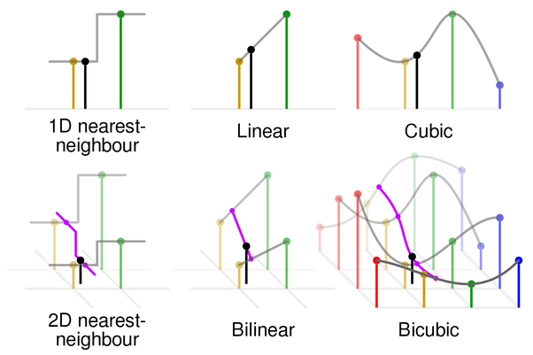
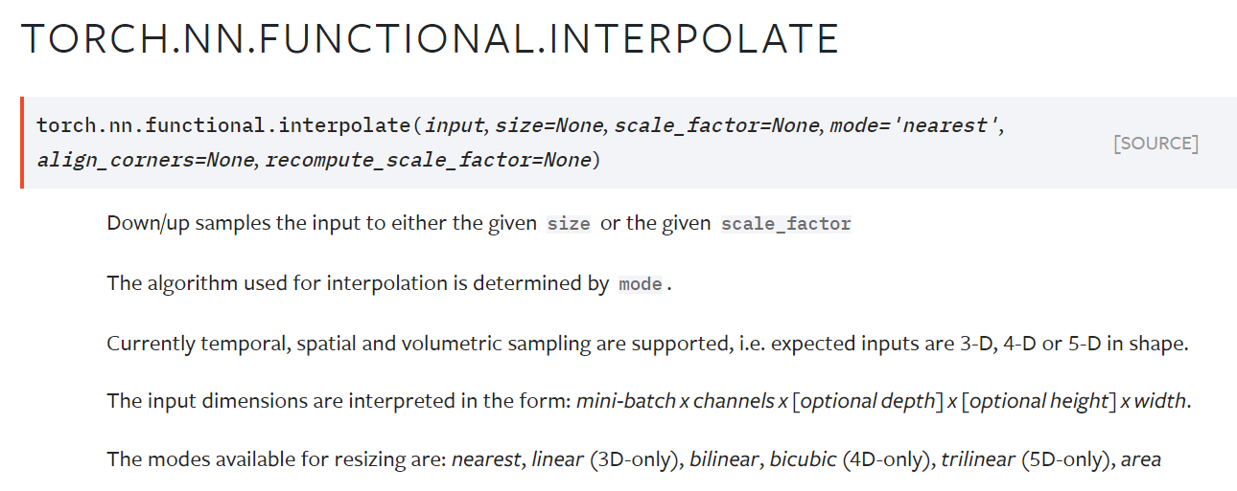
Use interpolation to resize images
Another “parameter free” way to resize images
It is a layer in NN
Differentiable by remembering the interpolation weights
Interpolation: use neighboring pixels to determine value of unknown location (weighted sum)
Weights depend on pixel location; no learnable parameters
https://www.quora.com/What-is-bicubic-interpolation-in-image-processing

Slide 38
Layers to adjust image size
Layers | Downsample | Upsample | Pro/Cons
Stride CONV | Yes | No | Same as normal conv, fast to compute
Pooling | Yes | No | Fast to compute, reduce the model power, less popular nowadays
Interpolation | Yes | Yes | Parameter free, fast to compute
Transpose CONV | Yes, but often not used for this | Yes | Has learnable parameters for upsampling
Pooling still is used in classification tasks
Full CONV architecture are more popular for other tasks, e.g. segmentation, super-resolution, denoising …

Slide 39
Batch Normalization

Slide 40








Ideally, Train, Dev, Test sets are from the same data distribution
Train
Dev
Test
Adjust model parameters
Unbiased estimation of model performance
Compare hyper-parameters
Unknown data distribution
Train
Dev
sample
Test
What we care in the end!

Slide 41


Test and Train sets can be from different distribution
https://www.clinicalradiologyonline.net/article/S0009-9260(17)30058-2/fulltext
10K, MRI images
1K, CT images

Slide 42
Test and Train sets can be from different distribution
Goal: Detect whether heart is imaged in MR images
 | Option1
Train | 8K MRI
Dev | 1K MRI
Test | 1K MRI
Option2
8K MRI+1K CT
1K MRI
1K MRI
Option3 | Option4
8K MRI | 8K MRI
1K MRI+1K CT | 1K MRI
1K MRI | 1K MRI +1K CT
10K, MRI images
1K, CT images

Slide 43

Test and Train sets can be from different distribution
Sample the Dev and Test sets from the same data distribution for the deployment time
10K, MRI images
Dev and Test sets define the target of the model
1K, CT images
https://www.google.com/url?sa=i&url=https%3A%2F%2Ftowardsdatascience.com%2Ftradeoff-bias-or-variance-1409eec38caf&psig=AOvVaw0FzJ-R_8JxUkPlAiJQax7Y&ust=1620153718709000&source=images&cd=vfe&ved=0CAIQjRxqFwoTCMCroImVrvACFQAAAAAdAAAAABAD

Slide 44
Test and Train sets can be from different distribution
Goal: Detect whether heart is imaged in CT images
 | Option1
Train | 500 CT
Dev | 250 CT
Test | 250 CT
Option2
10K MRI
500 CT
500 CT
Option3
10K MRI+500 CT
250 CT
250 CT
10K, MRI images
1K, CT images

Slide 45
Dev and Train set are from the different distribution
Goal: Detect whether heart is imaged in CT images
Bayes accuracy
Bias
Training accuracy
10K, MRI images
Variance
Dev accuracy
accuracy
Model variance can be overestimated, due to data mismatch
1K, CT images
epoch

Slide 46
Dev and Train set are from the different distribution
Train
Tra-Dev
Dev
Test
Adjust model parameters
Unbiased estimation of model performance
Compare hyper-parameters
Estimate data mismatch error
Split the train set further to get a Tra-Dev set
Train and Tra-Dev set have the same data distribution
Used to estimate model variance

Slide 47
Train, Tra-Dev, Dev and Test sets
Bayes accuracy
Bias
Training accuracy
Variance
TraDev accuracy
Data mismatch
Dev accuracy
Dev set overfitting
accuracy
Test accuracy
epoch

Slide 48




Spot problems : Error analysis
Error analysis : exam the incorrect/less-perfect samples in Dev set to spot the problems
Image is too dark
5%
New image view
11%
Image is flipped and with different contrast
14%
Typical sample in Train set

Slide 49
Spot problems : Error analysis
Error analysis : exam the incorrect/less-perfect samples in Dev set to spot the problems
Findings | Error rate | Remedies
Image is too dark | 5% | Add pre-processing
New image view | 11% | Acquire more data
Image is flipped and with different contrast | 14% | Add data augmentation

Slide 50
Iterate error analysis with training
Training Error | 67%
Dev Error | 65%
Correct for first findings: add data pre-processing, data augmentation, add new data
Training Error | 87%
Dev Error | 77%
Increase model depth + L2 Reg
Training Error | 95%
Dev Error | 94%
Second error analysis
Human-level-performance: ~ 100% detection rate
Iterative process
The key for deep learning is to decide what to do at each step
… …
Until meet the performance requirement

Slide 51
Speedup the error analysis
Eyeball set: a portion of dev set to check
Blackbox set: a portion of dev set to apply model, but not exam for error

Slide 52

Active selection
Use the model output to pick samples to check
Consider to use different metrics
Combine domain knowledge, e.g. signal-noise-ratio in different imaging protocols, image appearances in different diseases (such as hypertrophic cardiomyopathy)
Automate this process and optimize tools

Slide 53


Error analysis of a complex system
R-R interval, location of S-T wave
https://ecg.utah.edu/lesson/3
Model 1
Disease classification
Model 3
Segmentation of heart
Model 2

Slide 54
Error analysis of a complex system
Manually labeled R-wave
https://ecg.utah.edu/lesson/3
Model 1
Disease classification
Model 3
Manual segmentation
Model 2

Slide 55
Error analysis of a complex system
https://ecg.utah.edu/lesson/3
Model 1
Disease classification
Model 3
Manual segmentation
Model 2

Slide 56
Error analysis of a complex system
Manual label
https://ecg.utah.edu/lesson/3
Model 1
Disease classification
Model 3
Model 2

Slide 57
Error analysis of a complex system
Latent representation, Nx1
https://ecg.utah.edu/lesson/3
Model 1
Disease classification
Model 3
Debug as one big model
End-to-end training
Harder to isolate bugs
Latent representation, Tx1
Model 2

Slide 58
Outline
Set up the training, cont.
Data pre-processing
Model weight initialization
Tips for model training

Slide 59








Data pre-processing to reduce variation
Standardizing the input data and reducing the variation can help training
Resample to fixed resolution
High spatial resolution
Low spatial resolution
Fixed high resolution of 1mm²
Adjust image windowing

Slide 60



Data pre-processing to understand
Understand the “edge” samples, exclude the corrupted samples and correct wrong labels
An average of 3.4% errors across the 10 benchmark ML datasets
Has impact on evaluating different models
Noisy with artifacts
Signal loss due to devices
https://labelerrors.com/
https://l7.curtisnorthcutt.com/confident-learning

Slide 61
Data pre-processing
Normalize different dimension of input data, help optimization
Features with varying magnitude
After scaling and centering

Slide 62


Scale and centering
Normalize different dimension of input data, help optimization
$$X∈ℝ^{N×2}$$
$$X=X−np.mean(X, axis=0)$$
$$X=\frac{X−np.mean\left(X, axis=0\right)}{np.std(X, axis=0)}$$
Another approach often used: $X=\frac{X−np.mean\left(X, axis=0\right)}{np.amax\left(X, axis=0\right)−np.amin(X, axis=0)}$

Slide 63


PCA: Principal Component Analysis
diagonal
$$X∈ℝ^{N×2}$$
$$X=X−np.mean(X, axis=0)$$
$$\left[D, V\right]=np.linalg.eig\left(np.dot\left(X.T, X\right)/N\right)$$
$$X=np.dot(X, V)$$
$$X=X/{np.sqrt(X∙diagonal())}$$

Slide 64


PCA: Principal Component Analysis
$$X∈ℝ^{N×D}$$
If the input dimension D is large, dimension reduction can be performed
$$\left[D, V\right]=np.linalg.eig\left(np.dot\left(X.T, X\right)/N\right)$$
$$X=np.dot\left(X, V\right)$$
$$X=X[:,0:K]$$
Only keep the top K dimension, $X∈ℝ^{N×K}$, can filter out some noise
These steps are also called “Whitening” :
the covariance matrix of X after applying the eigenvector and divided by sqrt(eigenvalue) becomes identity matrix

Slide 65

Tips for data processing
For image, often only apply centering and scaling
$$X=\frac{X−np.mean\left(X, axis=0\right)}{np.amax\left(X, axis=0\right)−np.amin(X, axis=0)}$$
Or simply, X=X/np.max(X) ← scale image to be [0, 1]
For time signal or multi-channel signals, PCA can be useful
Start simple and plot results from every preprocessing steps
Including the preprocessing in the regression test
Make sure the inference data go through the identical pre-processing steps
Computing the pre-processing statistics (e.g. dataset mean, eigen vectors, eigen values …) on the training set ONLY and applying them in inference
Complicated pre-processing can make model more vulnerable to data distribution shift

Slide 66
Outline
Set up the training, cont.
Data pre-processing
Model weight initialization
Tips for model training

Slide 67








Need a strategy to give weights some initial values
W₁^{[1]}
f
$$Z^{[1]}=W^{\left[1\right]}X+b^{[1]}$$
W₁^{[2]}
f
$$a^{[1]}=f(Z^{\left[1\right]})$$
$$X$$
W₂^{[1]}
f
W₁^{[3]}
f
$$a^{[3]}$$
$$Z^{[2]}=W^{\left[2\right]}X+b^{[2]}$$
$$a^{[2]}=f(Z^{\left[2\right]})$$
W₂^{[2]}
f
$$Z^{[3]}=W^{[3]}a^{[2]}+b^{[3]}$$
f
$${\hat{y}=a}^{[3]}=f(Z^{\left[3\right]})$$
W₃^{[1]}
How do we initialize weights and biases?

Slide 68







Need a strategy to give weights some initial values
How about W=0 and b=0?
$$Z^{[1]}=W^{\left[1\right]}X+b^{[1]}$$
All $Z^{[l]}$ will be zero
All $a^{[l]}$ will be a constant, depending on the non-linear activation function used
When performing backprop, then gradient will be zero …
So SGD cannot update network parameters …
$$a^{[1]}=f(Z^{\left[1\right]})$$
$$Z^{[2]}=W^{\left[2\right]}a^{[1]}+b^{[2]}$$
$$a^{[2]}=f(Z^{\left[2\right]})$$
$$Z^{[3]}=W^{[3]}a^{[2]}+b^{[3]}$$
$${\hat{y}=a}^{[3]}=f(Z^{\left[3\right]})$$

Slide 69


Need a strategy to give weights some initial values
How about W=$σ×$np.random.rand(input_D, output_D), zero-mean, gaussian random values
$$Z^{[1]}=W^{\left[1\right]}X+b^{[1]}$$
$W^{\left[1\right]}:$3xN matrix
$$Z_{k}^{[1]}=\sum_{i=0}^{N−1}{W_{k,i}^{[1]}x_{i}}+b^{[1]}$$
The k-th element of score Z
Let’s whitening the input X, so it has same variance for all features.
${Var(Z}_{k}^{[1]})=\sum_{i=0}^{N−1}{{Var((W}_{k,i}^{[1]})Var(x_{i})}+{Var(b}^{[1]})=Nσ^{2}$ $Var(x)$
Since all $x_{i}$ and $W_{k,i}^{[1]}$ are independent upon initialization, with zero mean
$Var\left(wx\right)=E\left(w^{2}\right)E\left(x^{2}\right)−{E(w)}^{2}$ ${E(x)}^{2}=E\left(w^{2}\right)E\left(x^{2}\right)=Var\left(w\right)Var(x)$
If w and x are independent and have zero mean

Slide 70





For deep network, activation function can be saturated
$σ$=0.01
$σ$=0.05
tanh activation was used
Figure credit: Stanford CS231N notes

Slide 71



Xavier Initialization
${Var(Z}_{k}^{[1]})=Nσ^{2}$ $Var(x)$
For a deep network, the non-linear activation can be saturated for native initialization
Make the learning harder
Sensitive to hyperparameter configuration
To keep the output variance unchanged:
W=np.random.rand(output_D, input_D)/np.sqrt(input_D)
$$σ=\frac{1}{\sqrt{N}}$$
$${Var(Z}_{k}^{[1]})=\sum_{i=0}^{N−1}{{Var((\frac{1}{\sqrt{N}}W}_{k,i}^{[1]})Var(x_{i})}+{Var(b}^{[1]})=Var(x)$$
Xavier Glorot and Yoshua Bengio, “Understanding the difficulty of training deep feedforward neural networks”, AISTAT 2010

Slide 72

He initialization: Xavier Initialization for ReLU activation
W=np.random.rand(output_D, input_D) × 2/np.sqrt(input_D)
$$σ=\frac{2}{\sqrt{N}}$$
To compensate the ReLU function for the negative inputs
$Var\left(wx\right)=E\left(w^{2}\right)E\left(x^{2}\right)−{E(w)}^{2}$ ${E(x)}^{2}=E\left(w^{2}\right)E\left(x^{2}\right)=Var\left(w\right)E\left(x^{2}\right)=\frac{1}{2}Var\left(w\right)Var\left(x\right)$
x is the response after RELU, which has positive mean
Use Xavier or He initialization
Bias is initialized to zero; randomness in weights often is sufficient to drive the training
With Batch Normalization, network training is much less sensitive to parameter initialization
He et al, “Delving Deep into Rectifiers: Surpassing Human-Level Performance on ImageNet Classification”, ICCV 2015

Slide 73

He initialization: Xavier Initialization for ReLU activation
$Var\left(wx\right)=E\left(w^{2}\right)E\left(x^{2}\right)−{E(w)}^{2}$ ${E(x)}^{2}=E\left(w^{2}\right)E\left(x^{2}\right)=Var\left(w\right)E\left(x^{2}\right)=\frac{1}{2}Var\left(w\right)Var\left(x\right)$
x is the activation after RELU, which has positive mean
y is the score before ReLU:
x = max(0, y)
y has zero-mean and symmetric distribution,
if the network is in good condition before this layer
https://stats.stackexchange.com/questions/138035/variance-calculation-relu-function-deep-learning

Slide 74
Outline
Set up the training, cont.
Data pre-processing
Model weight initialization
Tips for model training

Slide 75
Debug deep neural network model can be difficult
Initial decision
Model
architecture
Evaluation
Bias-Variance analysis
Adjustment, model and data
Implementation
Implementation
Iteration
often slow
Model
performance
Datasets
How the
training is conducted
Hyperparameter
searching
deployment
Influenced by several factors

Slide 76

Before you started …
Elo rating
Have an estimation of Bayes accuracy
Human level performance as a surrogate
Expert performance – experienced operators vs. less experienced
Voting strategy
Baseline and results from publications
Whether it has related competition
https://www.drdobbs.com/parallel/computer-chess-the-drosophila-of-ai/184405171

Slide 77

Before you started …
Have the Dev and Test set established
Dev and test sets should be large enough to give a reliable estimation of model performance
If the total amount of data is small, get more data and use cross-validation
https://machinelearningmastery.com/learning-curves-for-diagnosing-machine-learning-model-performance/

Slide 78


Before you started …
Have the evaluation metric
Accuracy, Dice ratio, L2 distance, business specific metrics?
Pick the key metric
Accuracy=(TP+TN)/(TP+TN+FP+FN)
Precision=TP/(TP+FP)
Sensitivity=TP/(TP+FN)
Specificity=TN/(TN+FP)
F1 score=2 x Pre x Sen / (Precision+Sensitivity)
https://towardsdatascience.com/confusion-matrix-for-your-multi-class-machine-learning-model-ff9aa3bf7826

Slide 79

Before you started …
Have the expectation
Know when to stop
Be the state-of-the-art?
Meet the business needs?
Consider the resource limitation
Data and computing
90% and 90.2% may be the same for your deployment
https://paperswithcode.com/sota/image-classification-on-imagenet

Slide 80
Model architecture
Start from standard choices and make changes if needed
Look for available resources
Look for related publications
Read the code if possible and do not take it blindly
Tasks | First try
Image classification | Standard ResNet, e.g. implementation in Pytorch repo
Segmentation | Unet architecture
Language, NLP | Pre-trained GPT family models
Time series signal | Bidirectional RNN with LSTM
Tabular data | Dense MLP, DropOut, BatchNorm

Slide 81


Implementation
Pay attention to output layers
With the same base network, different functionalities can be achieved by changing the output layers:
Pooling and dense linear for classification
CONV layer for segmentation
Dense linear for regression
Pay attention to loss function – need logits or need probabilities?
different implementation may pack extra computation into loss function

Slide 82
Overfit a small dataset, e.g. one mini-batch
For classification, accuracy should quickly reach 100%
For segmentation, Dice ratio should quickly increase to ~1.0
Very useful to find implementation bugs:
Loss goes up
learning rate too high, error in output layer for class order…
Loss is NaN
Overflow or underflow or divided-by-zero
Accuracy plateaus
learning rate too low, bad initialization, regularization too high, data/label mismatch …
Train
Dev

Slide 83

Check the initial loss function, if making sense
These nodes will give roughly same scores for every class
Random initialized
All output classes are treated equally
For the binary classification, initial loss will be close to –log(0.5)
For the multi-class classification, initial loss will be close to –log(1/C), C is the number of total class

Slide 84


First turn off regularization/drop out/Batch Norm
$$L=\frac{1}{B}\sum_{i=0}^{B−1}{L^{\left(i\right)}}+\frac{λ}{2}{\left\|W\right\|}_{2}^{2}$$
Set $λ=0$ to begin with
Maker sure regularization loss not dominate total loss
Turn off operations to introduce randomness to training, e.g. drop out
Add controls to allow turn them on/off easier
Consider to turn off batch norm at first trials, since BN layer can hide problem such as NaN in computation, explosion/vanishing gradients, and make debug harder
With BatchNorm, make sure Batch size large enough (>16)

Slide 85



Check every steps, starting from pre-processing
Errors can happen in pre-processing, such as
forget to change label after processing images (e.g. image scaling for segmentation)
Errors can happen in datasets:
forget the shuffle the samples, some samples are corrupted …
Errors can happen when loading data:
image/label mismatch
L2 norm of all samples
Some images are blanket!
Scale the image and forget to scale mask

Slide 86


Check immediate inputs to your model training code
Print/plot/save a few mini-batch and check them before training
Batch A
Batch B

Slide 87

Check immediate outputs of your model before any post-processing
scores = model(images)
Goal : detect key landmarks
Model outputs are spatial probability maps
Postprocessing: extract landmark location

Slide 88

Add Debug mode and verbose mode, add working_dir
Easily enable or disable
Fast, not slow down training if disabled
Save intermediate results with its index/name/time stamp/data role …
Keep these code lines in your repo

Slide 89


Monitor the learning curves
Loss is not decreasing quickly
learning rate too low
model underfitting
try to fix the problem by fitting to a tiny dataset
https://machinelearningmastery.com/learning-curves-for-diagnosing-machine-learning-model-performance/

Slide 90

Monitor the learning curves
Loss goes up for dev set and goes down for training set
model overfitting
add regularization
reduce mode capacity
add more training data

Slide 91

Monitor the learning curves
Loss shows strong variance in dev set
model overfitting
training set too small
Add more sample to training set

Slide 92

Monitor the learning curves
Loss is lower for dev set than train set
dev set is easier than train set
too much data augmentation
dev/tra set distribution mismatch
exam dev set

Slide 93


Monitor the learning curves
Good training
Accuracy is high, but still increasing
Consider to train longer
Note with one-cycle scheduler, at high LR, the accuracy can dip

Slide 94



Use Debugger
Tensor shape mismatch
Loss function exceptions
Nan or inf error
All other exceptions …
set breakpoints
check variable values
interactive debugging
… …
or, pdb or ipdb for CLI experiences of debugging

Slide 95


Use Experimental management tools
My model is finally good,
but I forget how it was trained !
Record your training and parameters
Integrated with python training code
Support hyperparameter searching
Easy to compare different experiments
Many iterations may be needed to reach required performance

Slide 96
Do not use hyperparameter searching as the first remedy
Bias-Variance analysis
Initial decision
Evaluation
Bias-Variance analysis
Adjustment, model and data
Implementation
Fix bias
Start hyperparameter searching after fixing obvious bias/variance problems
Often large performance gain is from error analysis and collecting specific new data for problems found
Fix bias/variance problems can change model and which hyperparameters to tune
Iteration
Fix variance
Fix train/dev
data mismatch
Hyperparameter
searching
deployment
Has
new issues?
Yes
No

